Slide 1

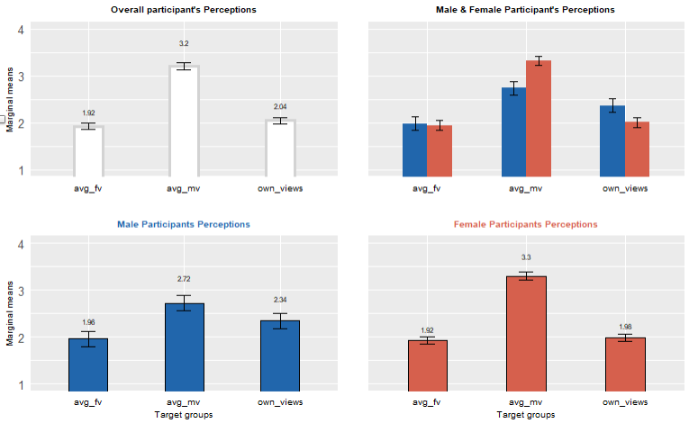
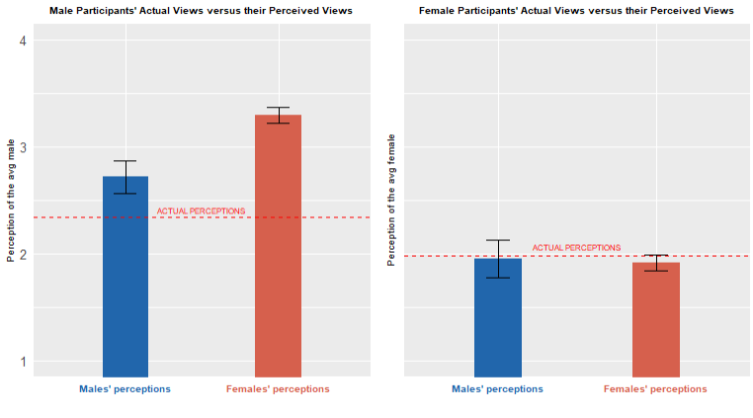
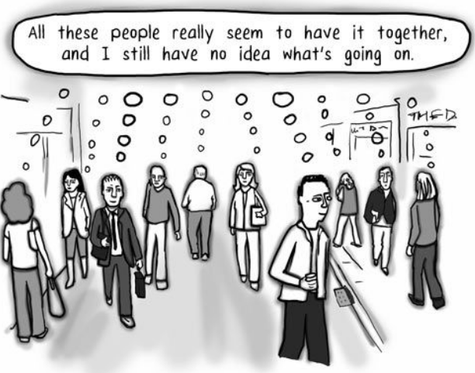
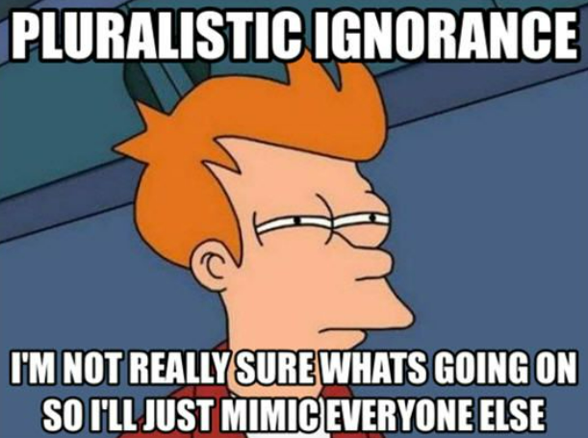


The Impact of Pluralistic Ignorance on Gender Bias
Selam Mekonnen, Dr. Travis J. Carter
Introduction
Repeated Measures ANOVA
Post hoc Analysis
One Sample T tests
Pearson’s Correlation
Relationship between PI & Sexist Attitudes
Pluralistic ignorance (PI) is a social psychological phenomenon where a majority of group members privately reject a norm, but incorrectly assume that most others accept it, and therefore go along with it¹.
PI has been identified as a significant factor contributing to the persistence of gender bias in society².
Studies have also indicated that men are prone to pluralistically ignorant views on gender bias, which can affect their attitudes and behaviors³.
A study on PI and gender bias highlighted the need for a better understanding of how men's attitudes and beliefs impact their behavior⁴.
Accordingly, this study aims to investigate the association between PI and sexist attitudes, in addition to meticulously exploring PI across gender.
Wrongly assume the majority are okay with it
Conform to perceived norms to avoid repercussions
Display sexist attitudes or fail take action
Believe sexist attitudes are inappropriate
Exacerbate sexism in society
Figure 1: Participants’ own perceptions & their perceptions of others .
Results
Discussion
The study supports the hypothesis that individuals with PI exhibit more sexist attitudes.
Both men and women exhibit PI regarding the average male's view on gender bias.
Women do not exhibit PI about other women's stance on gender bias.
Female participants exhibited more accurate understanding of other women's stance on gender bias, potentially indicating greater vocalization of gender issues among women.
Men exhibit higher PI for both the average male's & female's views.
Consistent with past studies indicating PI among men⁶
Sexist attitudes were lower for male participants indicating their true beliefs regarding gender bias.
Strong correlation was revealed between sexist attitudes & PI for both male and female participants
The relationship was stronger for males.
Misperception of gender bias norms could exacerbate gender bias in society.
Raising awareness about societal perceptions of gender bias reduces PI, reducing sexist attitudes & behaviors in the long term
In general, the study's results have crucial implications reducing gender bias suggesting creating awareness about societal norms.
Limitations: include reliance on self-reported data, a small sample size, and a disproportional sample distribution.
Future research: should focus on addressing limitations of current study and should investigate the relationship between long-term exhibition of sexist attitudes caused by PI and its potential link to normative conformity.
Methods
The survey asked participants to rate the level of appropriateness of hypothetical sexist scenarios that are commonly recognized but perceived as less offensive.
Participants' personal views of the scenarios, as well as their beliefs about how other males and females might perceive them, were sought to gain insight into their perceptions.
The survey employed a rating scale that was adapted from established measures of gender bias and PI.
Participants rated their responses on a 5-point scale ranging from 1 (extremely inappropriate) to 5 (extremely appropriate) across three groups:
Their own perceptions,
The average male's perceptions, and
The average female's perceptions.
References
¹Munsch, C., Weaver, J., Bosson, J., & O'Connor, L. (2018). Everybody but Me: Pluralistic Ignorance and the Masculinity Contest. Journal of Social Issues, 74(3), 551-578.
²Sobotka, T. (2020). Not Your Average Joe: Pluralistic Ignorance, Status, and Modern Sexism. Men and Masculinities, 1097184.
³Van Grootel, S., Van Laar, C., Meeussen, L., Schmader, T., & Sczesny, S. (2018). Uncovering Pluralistic Ignorance to Change Men's Communal Self-descriptions, Attitudes, and Behavioral Intentions. Frontiers in Psychology, 9, 1344.
⁴De Souza, L., & Schmader, T. (2021). The misjudgment of men: Does pluralistic ignorance inhibit allyship? Journal of Personality and Social Psychology, 2021-04-19.

